Slide 1
MACHINE LEARNING
DECISION TREE

Slide 2
TABLE OF CONTENT
What is Decision Tree?
Use of Decision Tree
Decision Tree Terminologies
Work-flow
Advantages
Disadvantages

Slide 3
What is Decision Tree?
Decision Tree is a decision-making tool that uses a flowchart-like tree structure or is a model of decisions and all of their possible results.
This algorithm falls under the category of supervised learning algorithms.
It works for both continuous as well as categorical output variables.
In order to build a tree, we use the CART algorithm, which stands for Classification and Regression Tree algorithm.
In Decision tree regression observes features of an object and trains a model in the structure of a tree to predict data in the future to produce meaningful continuous output.

Slide 4
Use of Decision Tree
There are various algorithms in Machine learning, so choosing the best algorithm for the given dataset and problem is the main point to remember while creating a machine learning model. Below are the two reasons for using the Decision tree:
Decision Trees usually mimic human thinking ability while making a decision, so it is easy to understand.
The logic behind the decision tree can be easily understood because it shows a tree-like structure.

Slide 5
Decision Tree Terminologies
Root Node: Root node is from where the decision tree starts. It represents the entire dataset, which further gets divided into two or more homogeneous sets.
Leaf Node: Leaf nodes are the final output node, and the tree cannot be segregated further after getting a leaf node.
Splitting: Splitting is the process of dividing the decision node/root node into sub-nodes according to the given conditions.
Branch/Sub-Tree: A tree formed by splitting the tree.
Pruning: Pruning is the process of removing the unwanted branches from the tree.
Parent/Child node: The root node of the tree is called the parent node, and other nodes are called the child nodes.

Slide 6
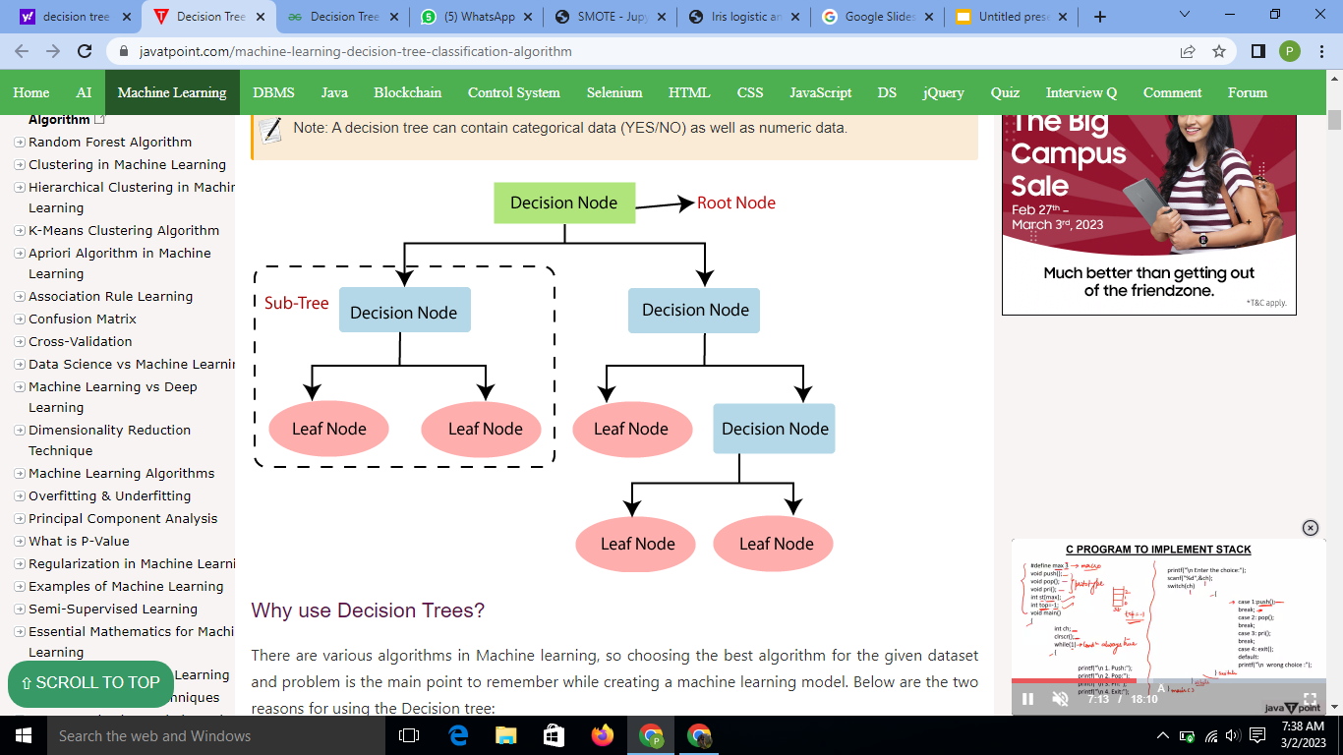
Workflow

Slide 7
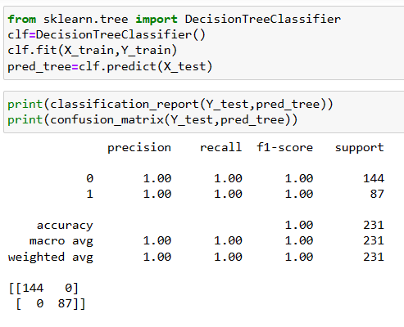
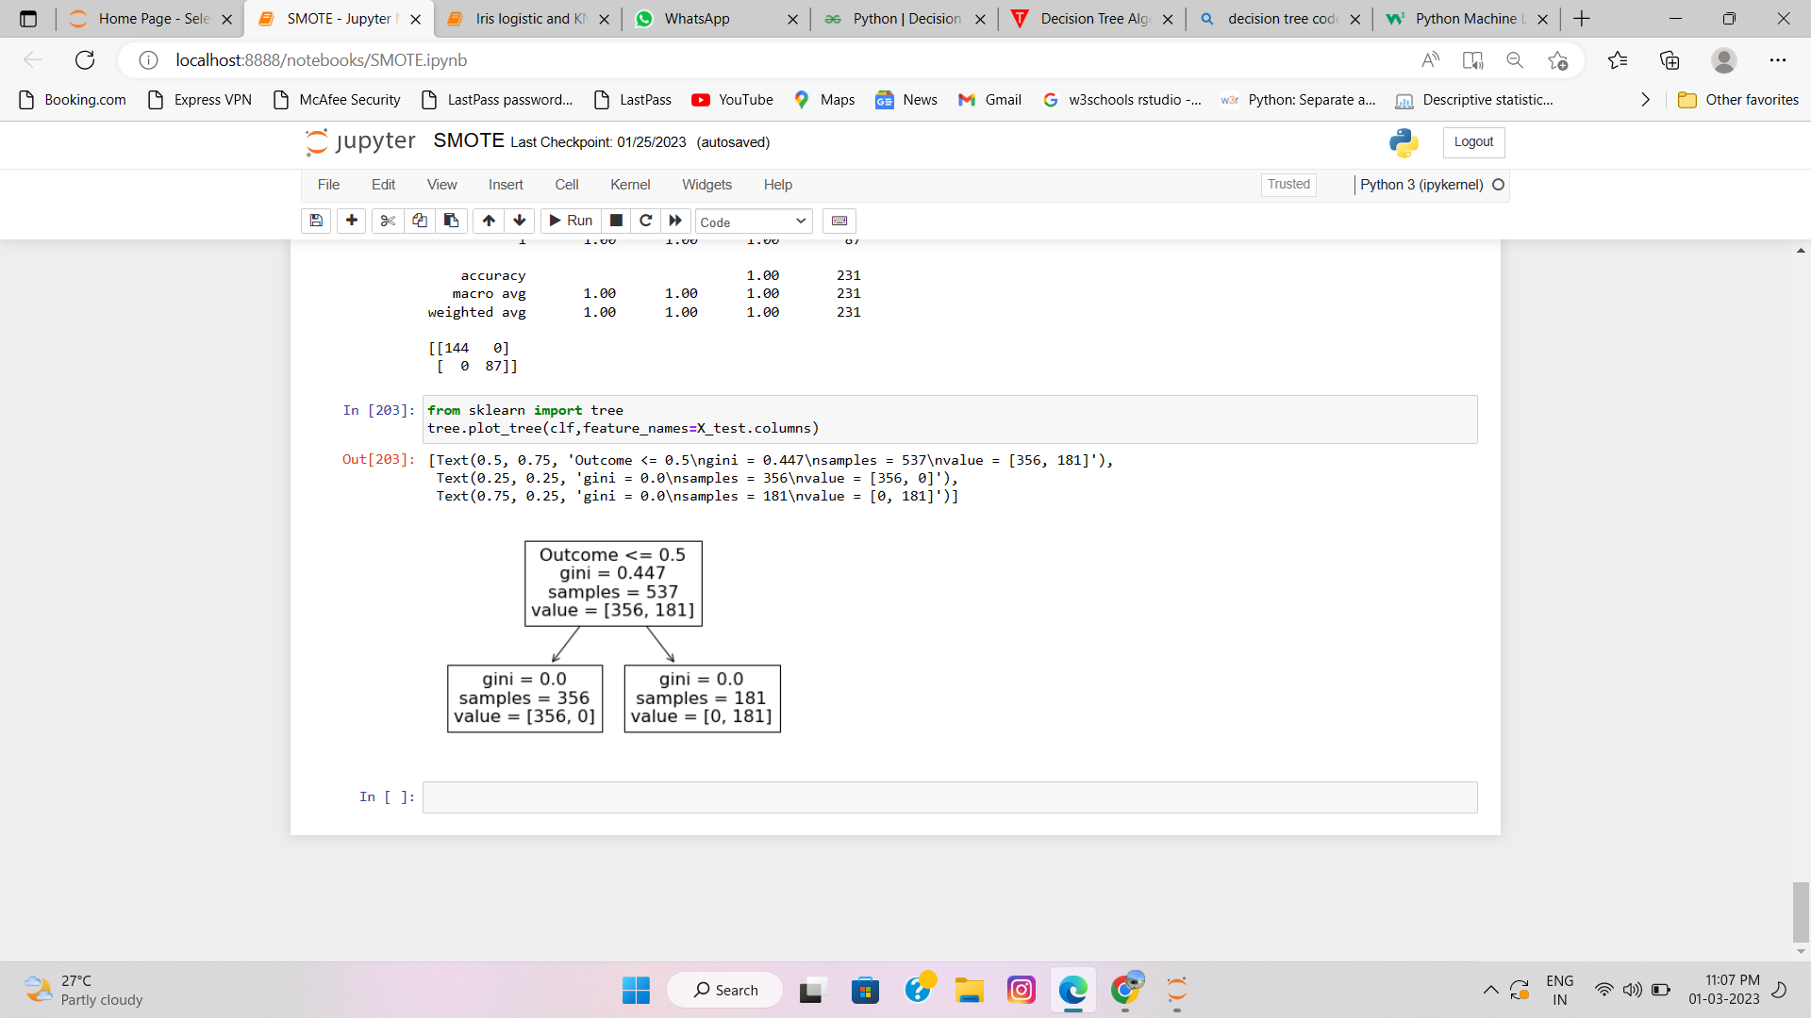
Implementation:

Slide 8
Steps followed
Data Pre-processing step
Fitting a Decision-Tree algorithm to the Training set
Predicting the test result
Test accuracy of the result(Creation of Confusion matrix)
Visualizing the test set result.

Slide 9
Advantages of the Decision Tree
It is simple to understand as it follows the same process which a human follow while making any decision in real-life.
It can be very useful for solving decision-related problems.
It helps to think about all the possible outcomes for a problem.
There is less requirement of data cleaning compared to other algorithms.

Slide 10
Disadvantages of the Decision Tree
The decision tree contains lots of layers, which makes it complex.
It may have an overfitting issue, which can be resolved using the Random Forest algorithm.
For more class labels, the computational complexity of the decision tree may increase.
They are largely unstable compared to other decision predictors.

Slide 11
THANK YOU

